Slide 1

Web Development (HTML)
iCog Anyone Can Code(iCog - ACC)
Prepared by: Getachew Muhabaw (Software Engineer)
January 26, 2023

Slide 2

Table of Contents
Basics thing for web
Introduction of HTML
HTML Boilerplate
01
03
05
07
02
04
06
Background of Web
History of HTML
HTML Element and Tags
Statement of the Problem
Conclusion

Slide 3
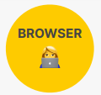


What is Web?
WWW
Web is the common name for the World Wide Web, it is subset of the Internet consisting of the pages that can be accessed by a Web browser.
Request
Response

Slide 4
What is HTML?
HTML Stands for Hyper Text Markup Language
HTML:
Is the standard markup language for creating Web pages
Describes the structure of a Web page
Consists of a series of elements
Elements tell the browser how to display the content
Elements label is pieces of content

Slide 5
History of HTML
The first version of HTML was written by Tim Berners-Lee in 1993.
HTML1
1993
HTML2
1995
HTML3
1997
HTML4
1999
HTML5
2014
Only support text and controls
Tables and fonts were not supported
Improved of Html 1
Forms were developed i.e textbox, buttons, text area etc
Further improved of Html2
Support of CSS
Still not supported markup tags
CSS were embedded in HTML page itself.Markup tags were supported
It comes lots of html tags support like
Email, password, audio tag, section tag etc

Slide 6
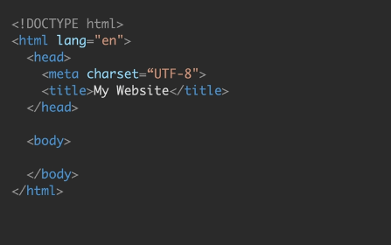
HTML Boilerplate
HTML has the following boilerplate when we create it
meta tags and links area
Main Working area

Slide 7

HTML Element and Tags
What is HTML Element ?
An HTML element is a type of HTML document component that include everything from the start tag to the end tag
What is an HTML Tag?
An HTML tag is a piece of markup language used to indicate the beginning and end of an HTML element in an HTML document.
HTML tags help web browsers convert HTML documents into web pages.
Element
So it HTML element contains
Opening tag
Content
Closing tag
Opening tag
Content
Closing tag

Slide 8
HTML Tags
Document Structure
<html> </html> : Html document
<head> </head>: head of html document
<title> </title>: Title of the web page
<body> </body>: Body of the document

Slide 9
...HTML Tags
2. Content (Container) Tags
h1-h6 : headings h1 is the largest and h6 is the smallest
<p> </p>: paragraph
<div> </div>: A container for a block of content
<span> </span>: A container for in-line content,
<em> </em>: Gives the contained text emphasis (usually as italics)
<ol> </ol>:Ordered (numbered) list
<ul> </ul>:Unordered (bulleted) list
<li> </li>: List item, must be nested inside a list element such as a <ol> or <ul>
<strong> </strong>: Makes the contained text bold

Slide 10
...HTML Tags
3. HTML5 Semantic Tags
<header> </header>:Contains introductory content for a page (e.g., a banner), or a section of a page.
<nav> </nav>:Contains navigation content, such as a website navigation menu.
<main> </main>: Contains the main content of the web page.
<aside> </aside>: Contains content that is tangentially related to the main content of the page (often this is presented in a sidebar).
<footer> </footer>:Contains the footer of a page, or of a section of a page. Typically the footer contains information about the content, such as the author and a copyright statement

Slide 11

...HTML Tags
5. Self closing tags: It has not closing tag
<hr/>: To make horizontal line
<br/>: used to create a line break in the text
<input/>:specifies an input field where the user can enter data
<img/>: To insert Images
<link/>: To insert links
In HTML5 the slash is optional.
But it is recommend to always add the slash. Because, it provides a visual clue of non-closing tags

Slide 12
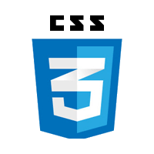
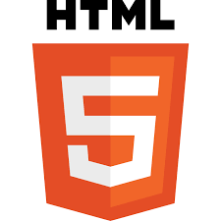

The 3 basic thing of web
Skeleton of the web
Nouns
<p></p>
p Means paragraph
Cloth of the web
Adjectives
p{color: red}
means
Paragraph text is red
Functionality for the web
Verbs
p.hide();
Means hide the paragraph

Slide 13
Conclusion
HTML (HyperText Markup Language):The HyperText Markup Language or HTML is the standard markup language for documents designed to be displayed in a web browser.
HTML is not a programming Language ⚠. Because HTML contains no programming logic.
Any type of web is operated by three files
HTML: It is the content of the website
CSS: Presentation(look) of the website
JavaScript: Dynamic effect of the website or Application of the website (Functionality of the web)

Slide 14

Thank You Q&A Time

